Slide 1
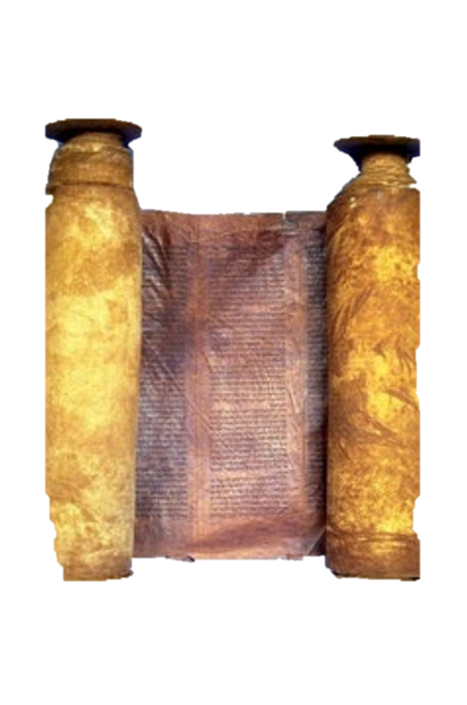
A free CD of this message will be available immediately following the service
1 Kings
14-16
A podcast will also be available later this week at calvaryokc.com

Slide 2
King-o-meter
Very bad
So-so
Very good
1 kings 14-16

Slide 3
Israel
Judah
Jeroboam, 931-910
1 kings 14-16

Slide 4
1 kings 14-16

Slide 5
Israel
Judah
Jeroboam, 931-910
Rehoboam, 931-913
1 kings 14-16

Slide 6
1 kings 14-16

Slide 7
Perverted persons ~ kjv, sodomites - male temple prostitutes (as in NIV, NASB)
1 kings 14-16

Slide 8
1 kings 14-16

Slide 9
1-2 Kings ~ probably written by Jeremiah (early 6th century BC)
1-2 Chronicles ~ probably written by Ezra (mid-4th century BC)
1 kings 14-16

Slide 10
1 kings 14-16

Slide 11
Israel
Judah
Jeroboam, 931-910
Rehoboam, 931-913
Abijam, 913-911
1 kings 14-16

Slide 12
1 kings 14-16

Slide 13
Israel
Judah
Jeroboam, 931-910
Rehoboam, 931-913
Abijam, 913-911
Asa, 911-870
1 kings 14-16

Slide 14
1 kings 14-16

Slide 15
Israel
Judah
Jeroboam, 931-910
Rehoboam, 931-913
Nadab, 910-909
Abijam, 913-911
Asa, 911-870
1 kings 14-16

Slide 16
1 kings 14-16

Slide 17
Tirzah
Israel
Ramah
Philistia
Jerusalem
Judah
1 kings 14-16

Slide 18
1 kings 14-16

Slide 19
Israel
Judah
Jeroboam, 931-910
Rehoboam, 931-913
Nadab, 910-909
Abijam, 913-911
Baasha, 909-886
Asa, 911-870
1 kings 14-16

Slide 20
1 kings 14-16

Slide 21
Israel
Judah
Jeroboam, 931-910
Rehoboam, 931-913
Nadab, 910-909
Abijam, 913-911
Baasha, 909-886
Asa, 911-870
Elah, 886-885
1 kings 14-16

Slide 22
1 kings 14-16

Slide 23
Israel
Judah
Jeroboam, 931-910
Rehoboam, 931-913
Nadab, 910-909
Abijam, 913-911
Baasha, 909-886
Asa, 911-870
Elah, 886-885
Zimri, 885
1 kings 14-16

Slide 24
1 kings 14-16

Slide 25
Israel
Judah
Jeroboam, 931-910
Rehoboam, 931-913
Nadab, 910-909
Abijam, 913-911
Baasha, 909-886
Asa, 911-870
Elah, 886-885
Zimri, 885
Omri, 885-874
1 kings 14-16

Slide 26
1 kings 14-16

Slide 27
Israel
Judah
Jeroboam, 931-910
Rehoboam, 931-913
Nadab, 910-909
Abijam, 913-911
Baasha, 909-886
Asa, 911-870
Elah, 886-885
Zimri, 885
Omri, 885-874
Ahab, 874-853
1 kings 14-16

Slide 28
1 kings 14-16

